Slide 1


Automating Scan-to-BIM for Telecom Site Planning
Chair of Circular Engineering for Architecture
Jeffrey Leisi
Midterm Presentation
Bachelor’s Thesis
03.04.2025
Notes:
Hi everyone, welcome to my midterm presentation about automating Scan-to-BIM for telecom site planning.

Slide 2
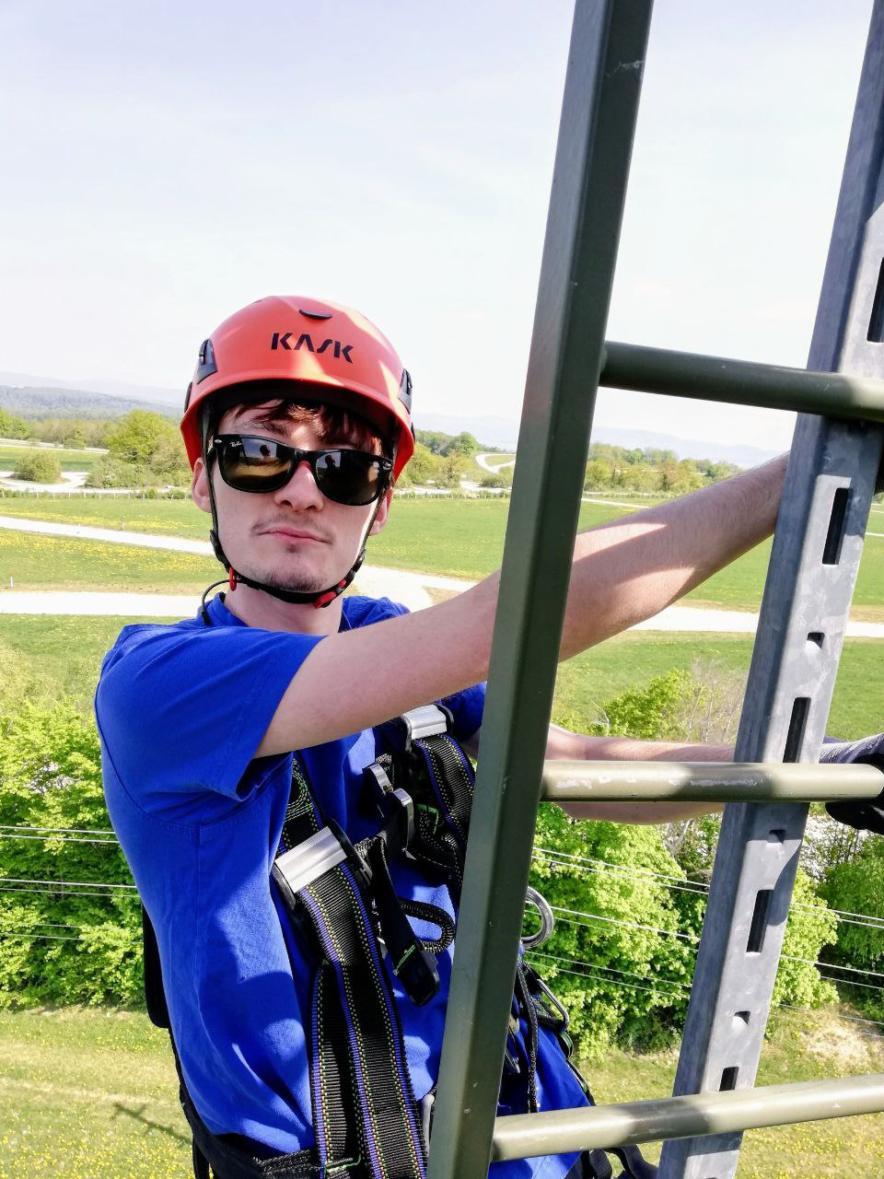
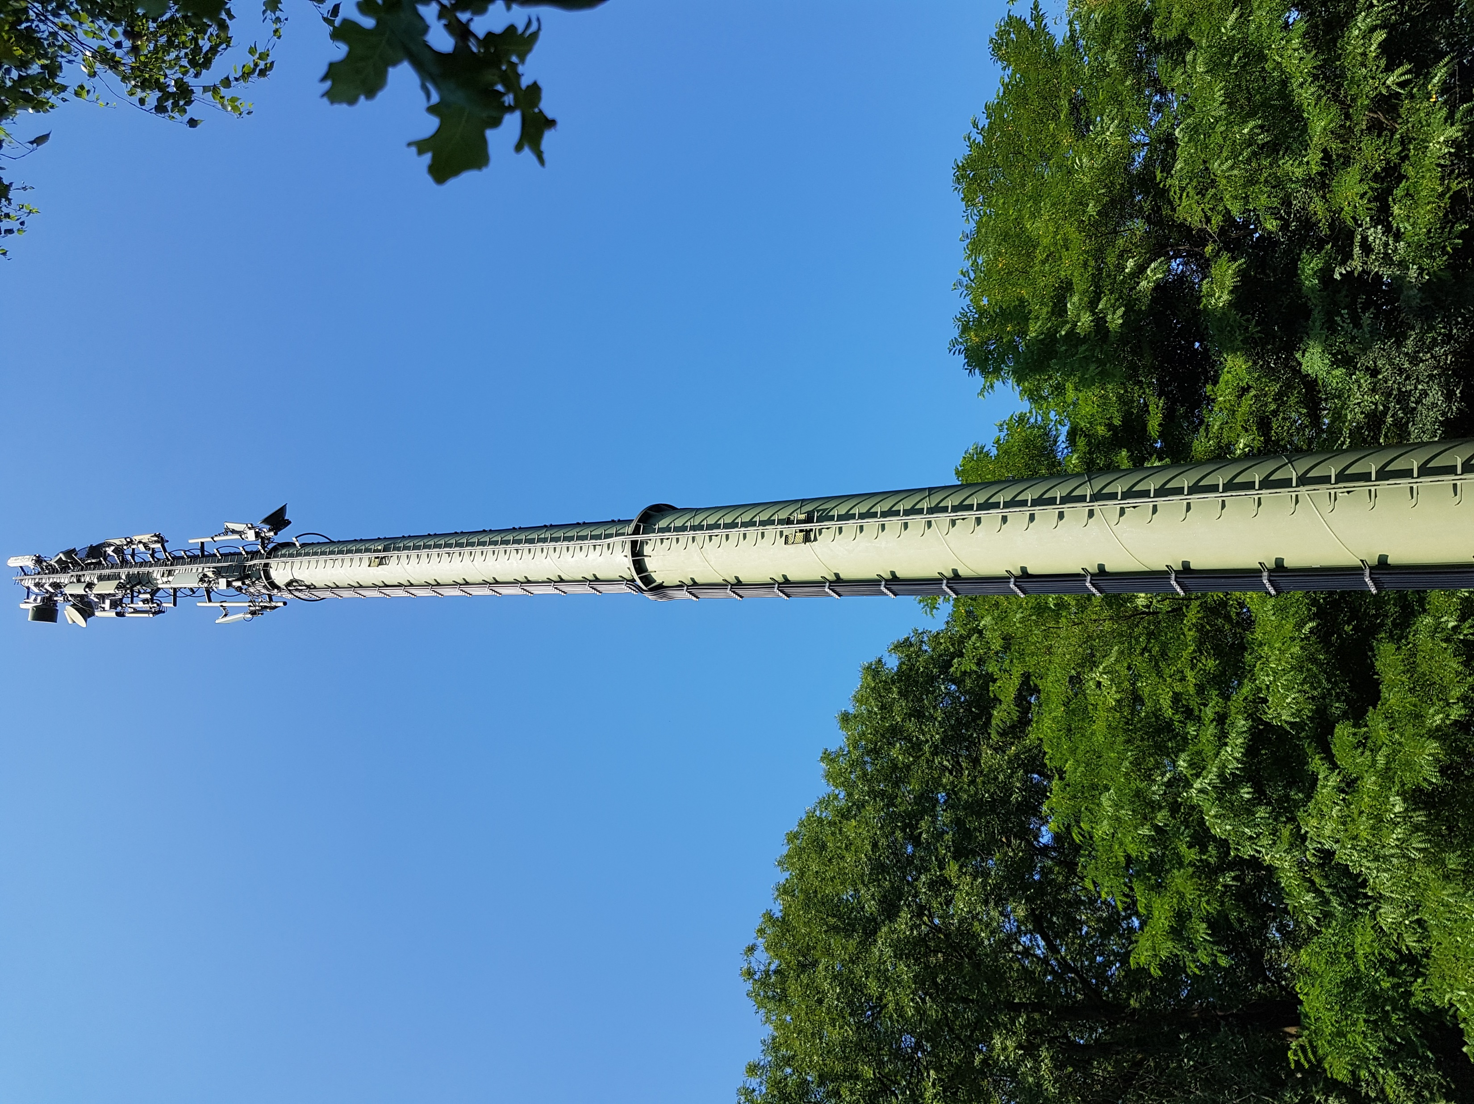
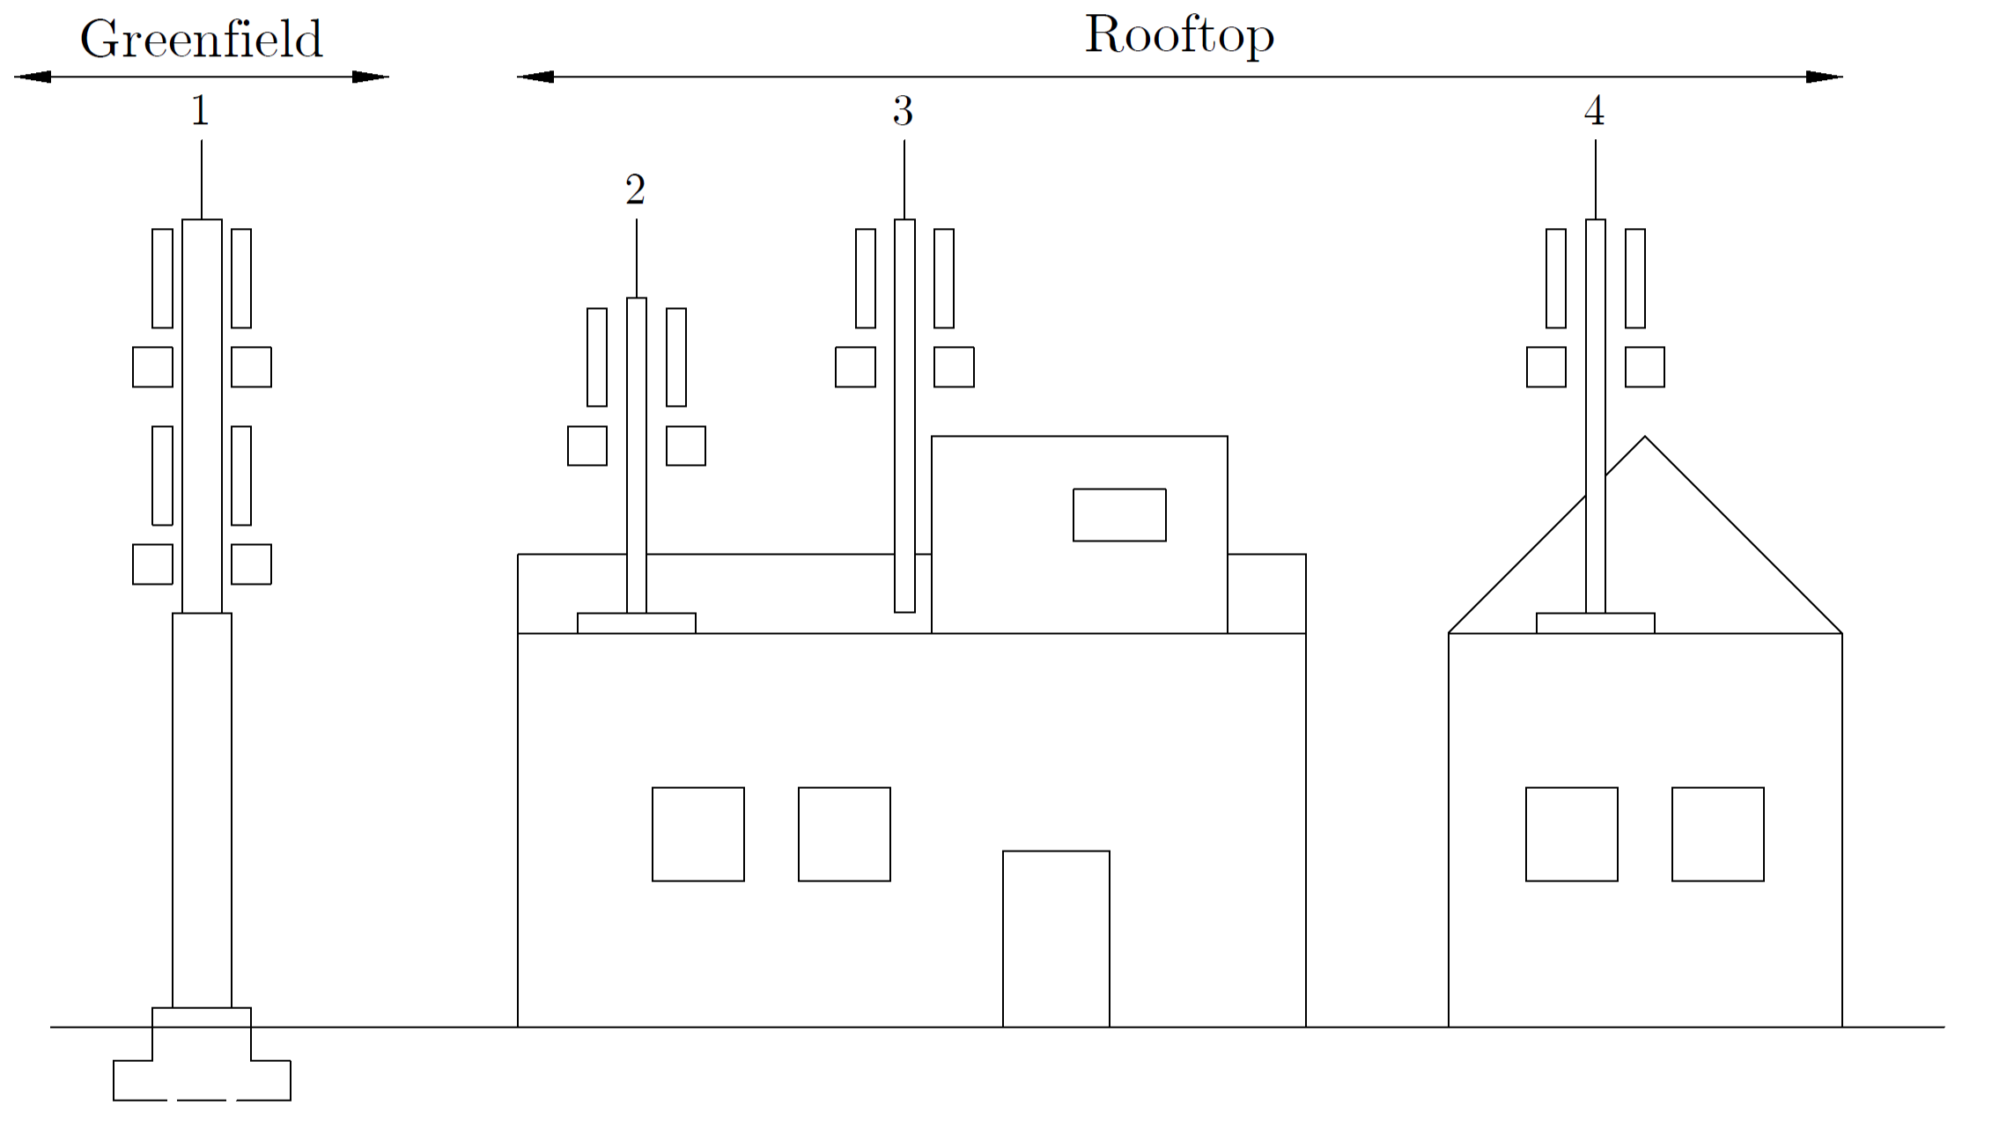

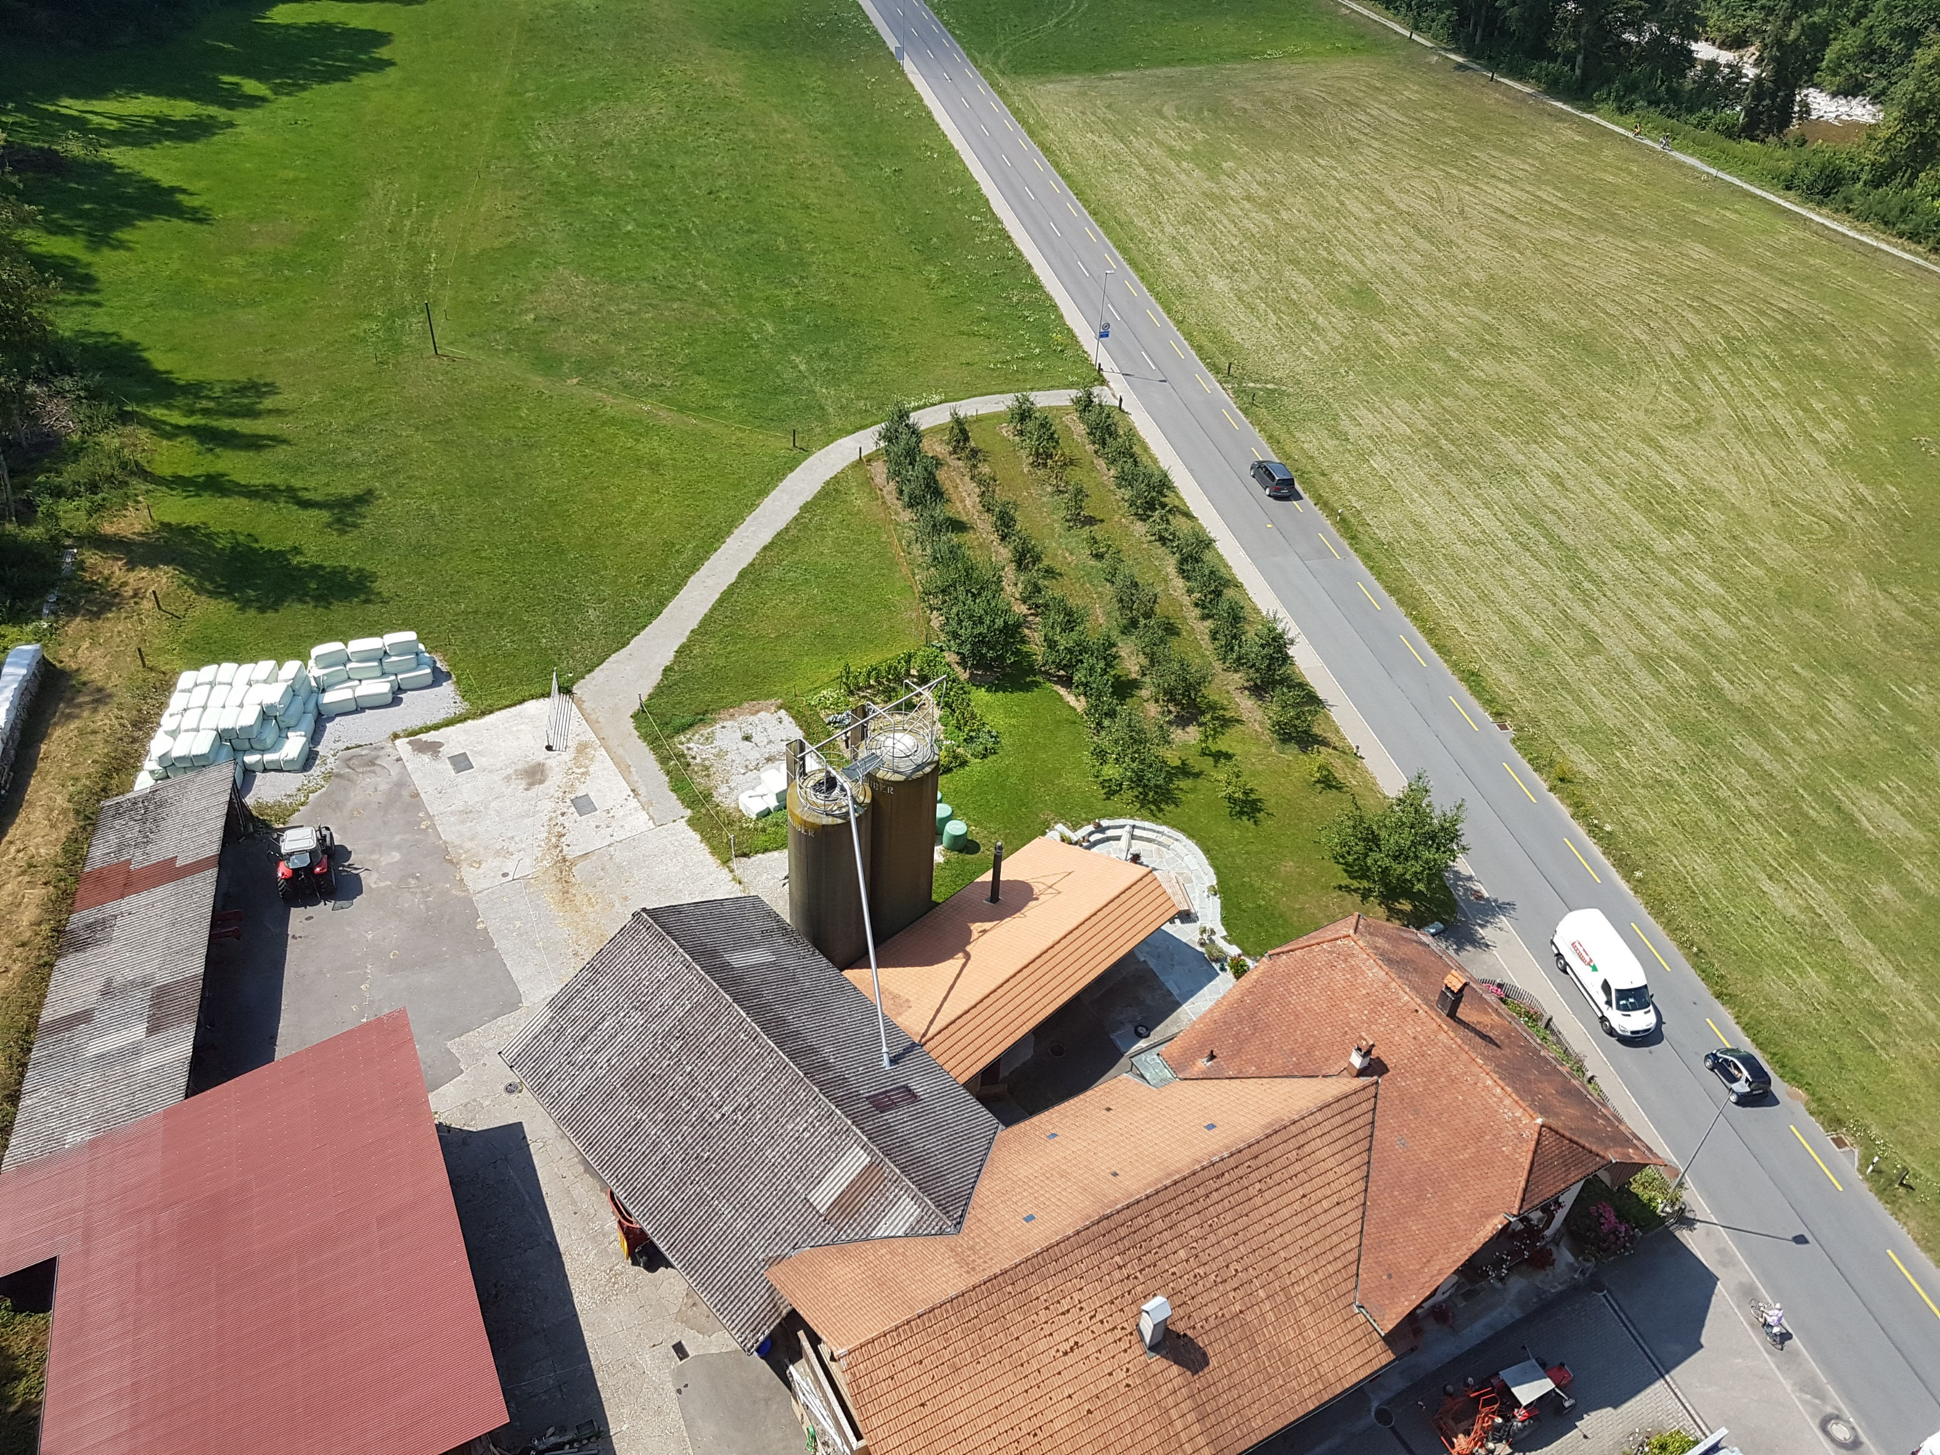
Introduction
About Me
Jeffrey Leisi
6 semesters geospatial engineering
4 years telecommunications
5 years civil and structural engineering
About Axians
International ICT provider (16,000 employees)
Part of VINCI Group (285,000 employees)
Notes:
I’m Jeff, and I’m currently in my 6th semester of geospatial engineering. I have a practical background. Before I came to ETH, I worked for several years in the telecom industry. I was a site engineer and responsible for the planning – from the site survey to the building permit. Before that, I worked for five years as a draftsman in a civil engineering office.
My bachelor’s thesis is a collaboration with my former employer, Axians Switzerland. In Switzerland, there are three mobile providers: Swisscom, Sunrise, and Salt. To build their infrastructure – fixed or mobile networks – they work with partners like Axians.
For several years now, Axians has acted as a total contractor. That means they not only build the infrastructure but also take care of the engineering tasks for cell sites. And for those planning tasks they are now looking for innovative solutions.
So, Axians builds cell sites. There are different. This one is a greenfield site. But in my thesis, I focus only on so-called rooftop sites – that means cell sites placed on top of buildings.

Slide 3
Problem Space

Slide 4

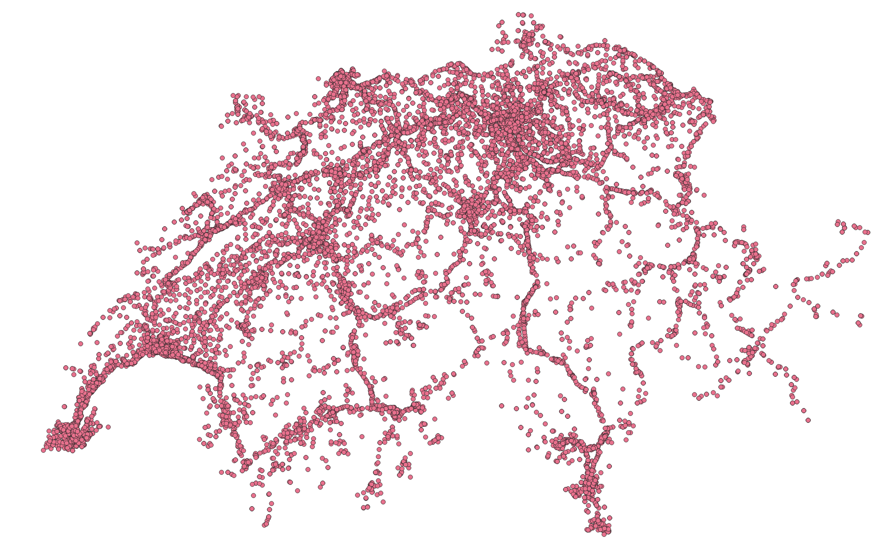
Problem Space: Driving Force
Mobile Data Traffic ↑
Strict NIR Regulations
Number of Cell Sites ↑
~ 20,000 existing sites
~ 7,500 new 5G sites (~ CHF 3.2 billion)
Notes:
Worldwide, mobile data traffic is still increasing exponentially. The main reason is video streaming with higher and higher resolution – it makes up nearly three-quarters of the traffic. Because of very strict radiation regulations in Switzerland, we have a very high density of cell sites. The allowed radiation levels are only one-tenth of what is allowed in most EU countries, like Germany or France.
There are already about 20,000 sites, and several thousand more are needed for the new 5G technology.
Now, let’s take a look at a simplified planning process.

Slide 5
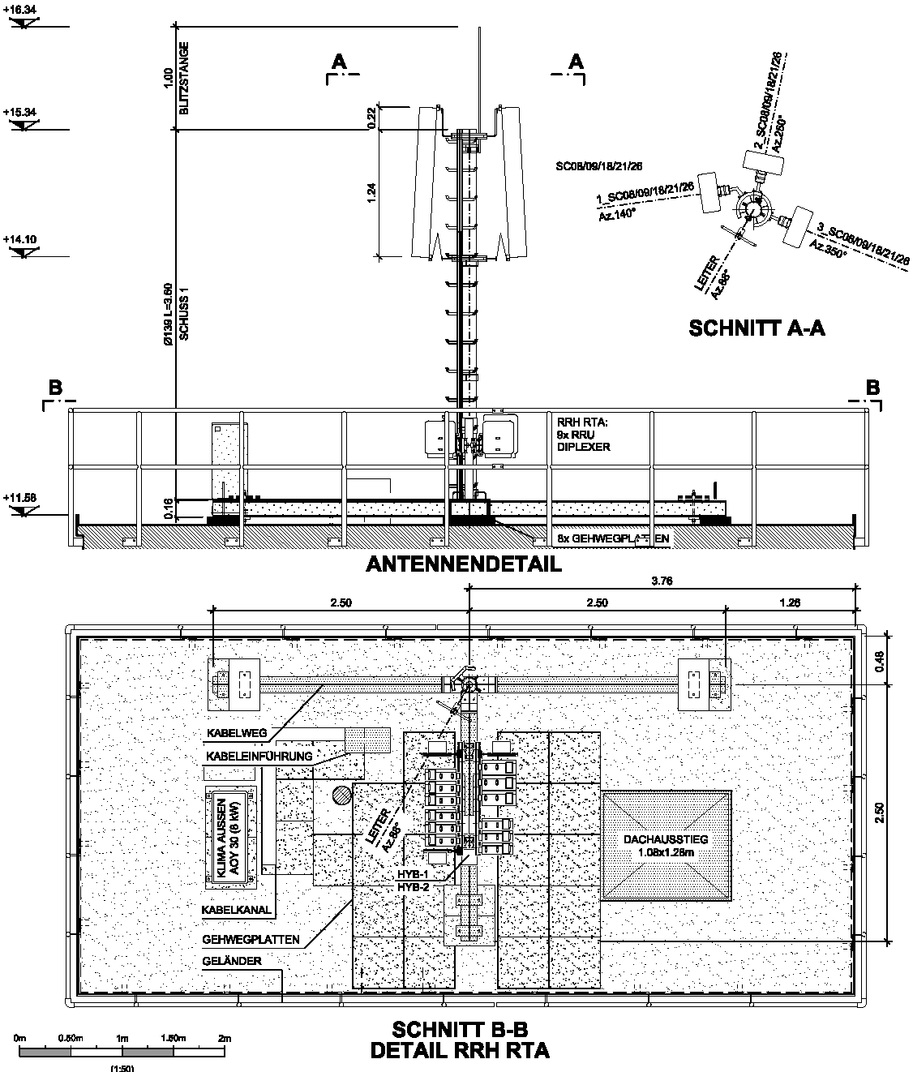
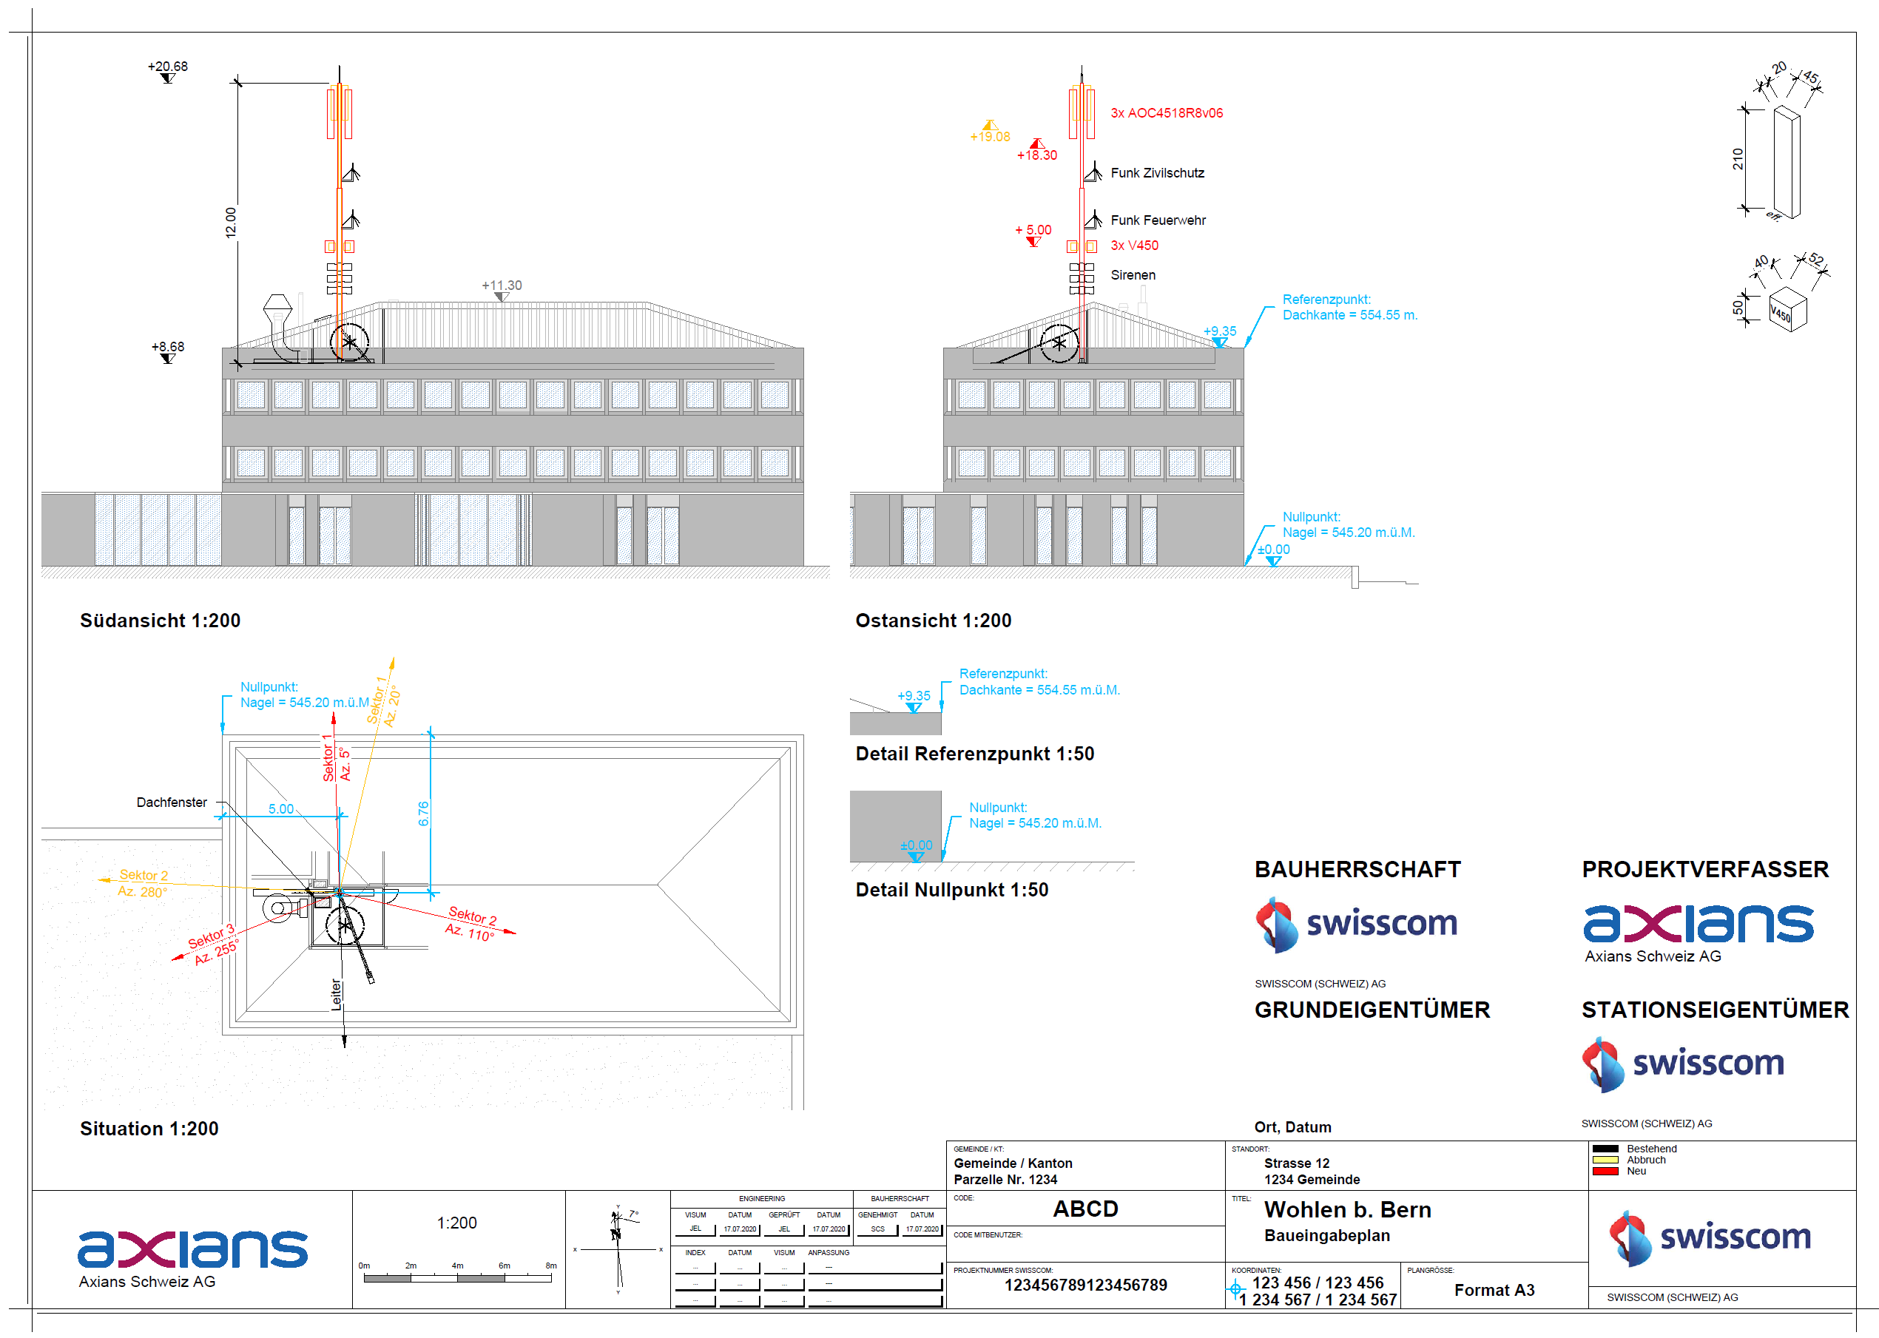
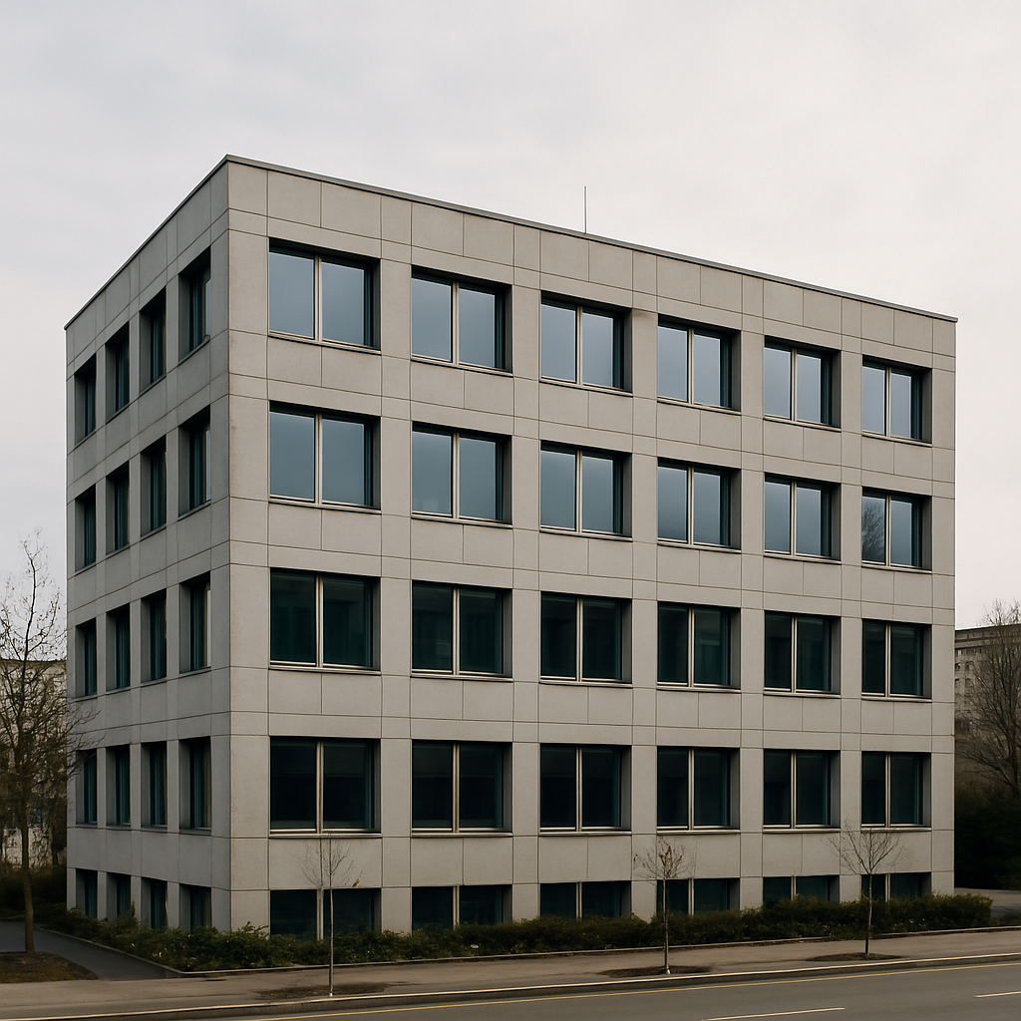
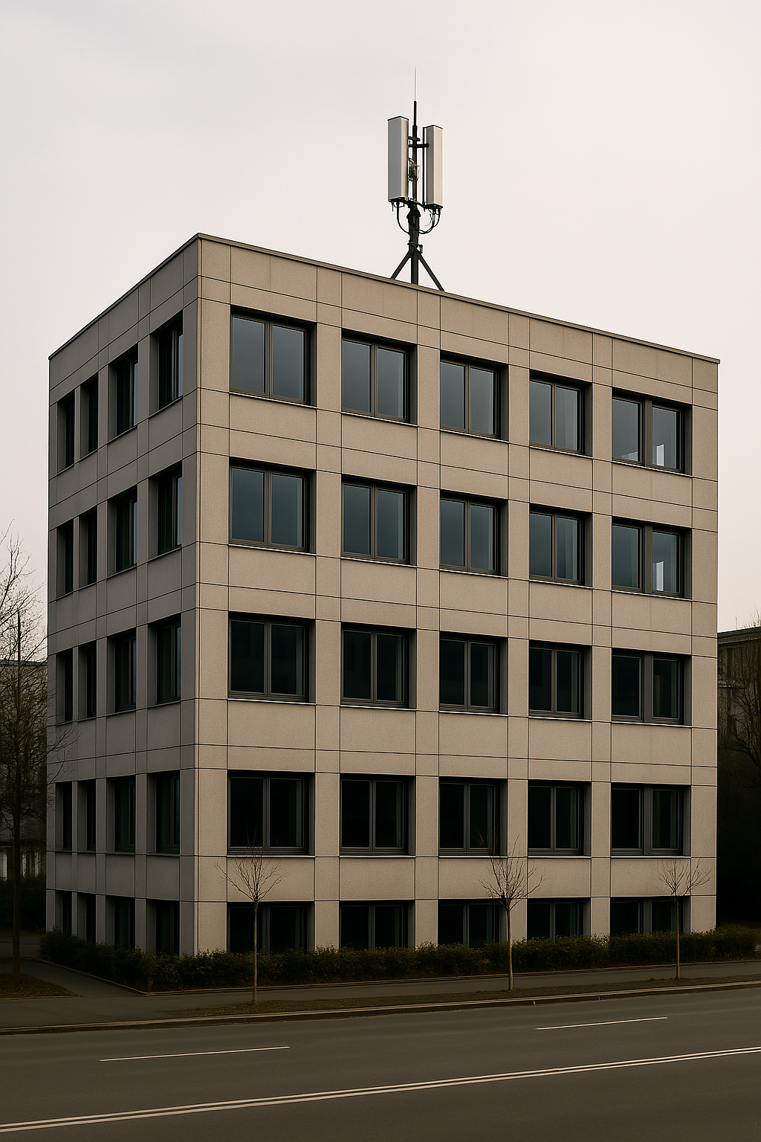
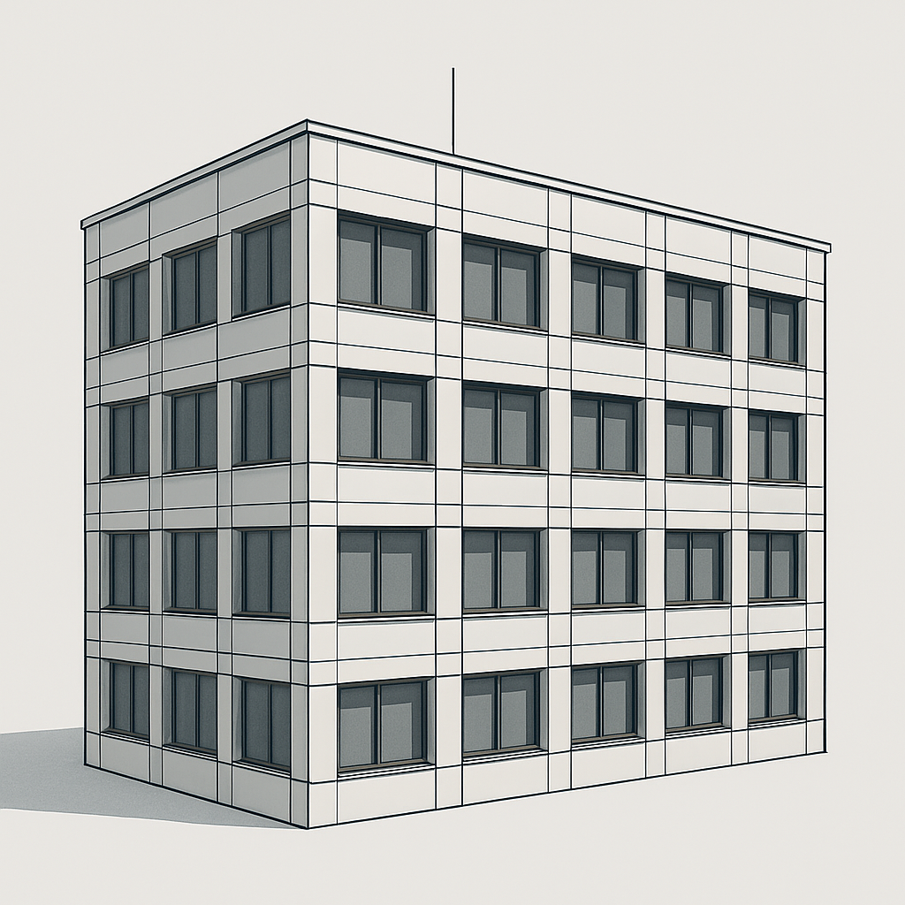
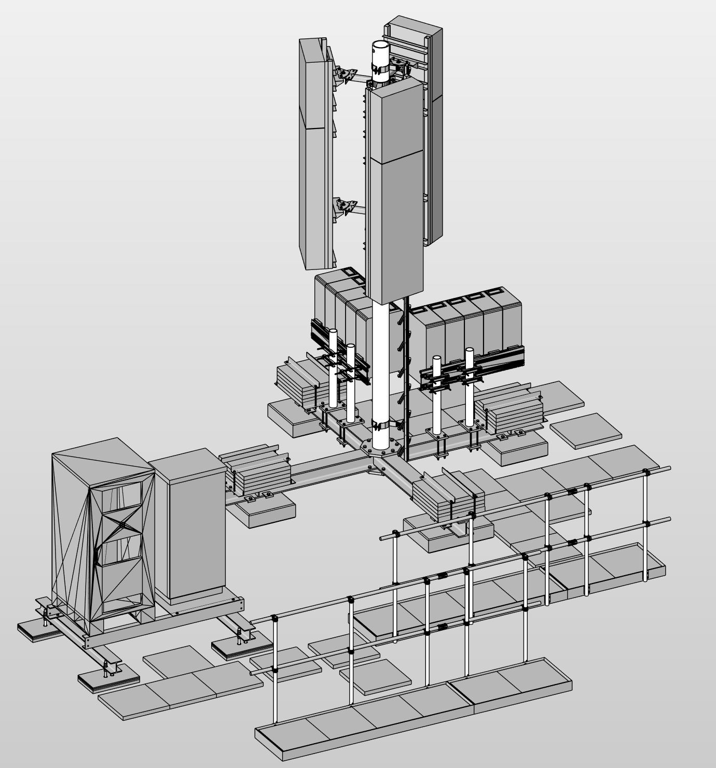
Problem Space: Site Planning Workflow
Site Survey
Standortbesichtigung
Schematic Design
Entwurfsplanung
Technical Design
Ausführungsplanung
Execution
Ausführung
conventional planning with CAD (2D):
Building Permit
Baubewilligung
Drawing
Scan-to-BIM
Model-based planning with BIM (3D):
BIM-Model
Notes:
After the provider has found a suitable building, a site survey is done. In Swisscom projects for example, it’s called the Detailprojektaufnahme. A team of specialists visits the building to inspect it.
CAD
Based on that, they create CAD building plans. If they are lucky, they can get existing building plans, which they scan and use for redrawing. If not, they have to draw everything from scratch.
Once the authority approves the permit, the planning for steelwork and site equipment begins. The final plans are then used for the execution phase.
BIM
In the future, they would like to switch to the BIM concept. That means creating a digital representation of the building – a so-called BIM model.
In addition to geometry, the model contains attributes.
For example: in CAD, a wall is shown as two lines with a fill. In BIM, a wall is a real object – with geometry, material information, and topology. It is connected to the floor and ceiling.
Once the BIM model is created, you can automatically generate the 2D plans from it.
Since BIM is already used in the execution phase, there is strong demand to also have the building available as a BIM model.
So now, they are looking for an efficient workflow to convert the real building into a digital representation.
This process is called Scan-to-BIM.
And that leads us to the research question:

Slide 6
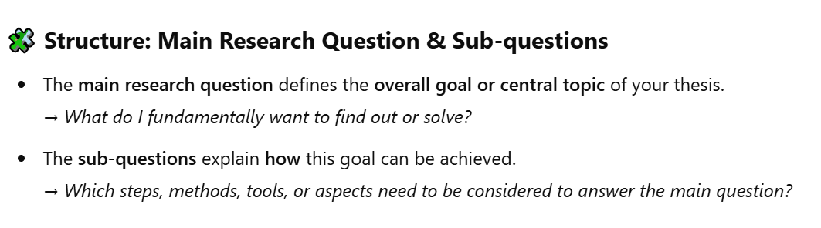
Problem Space: Research Questions
How can the Scan-to-BIM workflow for site planning in the telecommunications industry be automated?
Which level of simplification is acceptable for automated object extraction in rooftop site planning? → Definition of the Objectives
Which methods are suitable for developing an automated Scan-to-BIM framework for rooftop site planning? → Design and Development, focus on general methods
Which tools are suitable for developing an automated Scan-to-BIM toolchain for rooftop site planning? → Design and Development, focus on software
How can a Python-based artefact be developed to automate the Scan-to-BIM workflow for rooftop site planning? → Design and Development, focus on artefact
Which steps of the Scan-to-BIM workflow can be automated in the context of telecom site planning? → Design and Development
What benefits can be achieved by automating the Scan-to-BIM workflow in terms of time, cost, or accuracy? → Evaluation
How can the developed workflow be integrated into existing planning processes at telecom contractors? → Evaluation
Notes:
How can we automate this process?

Slide 7
Solution Space

Slide 8
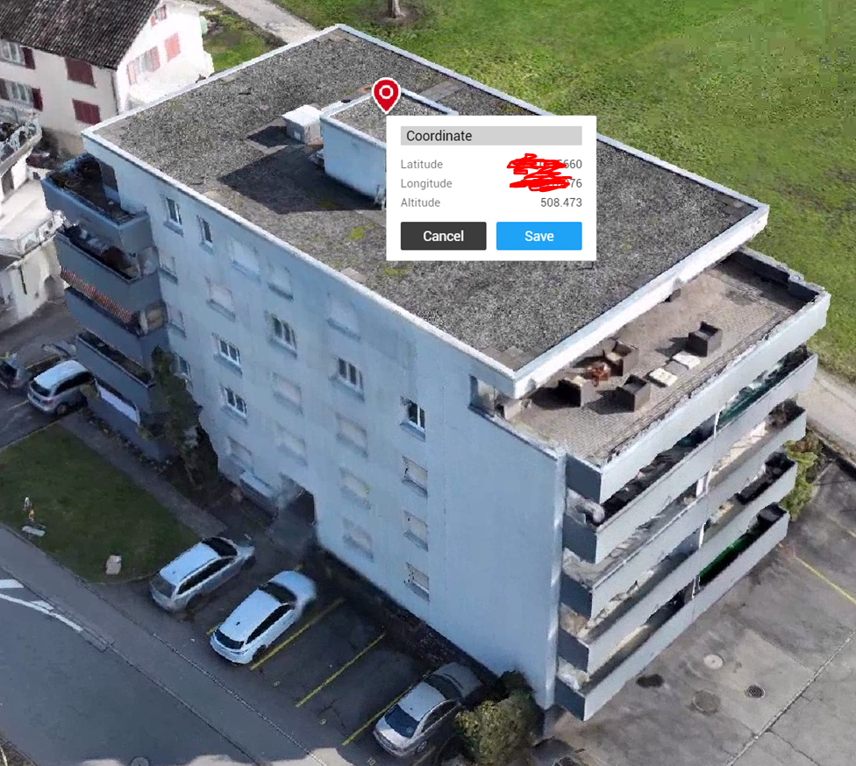
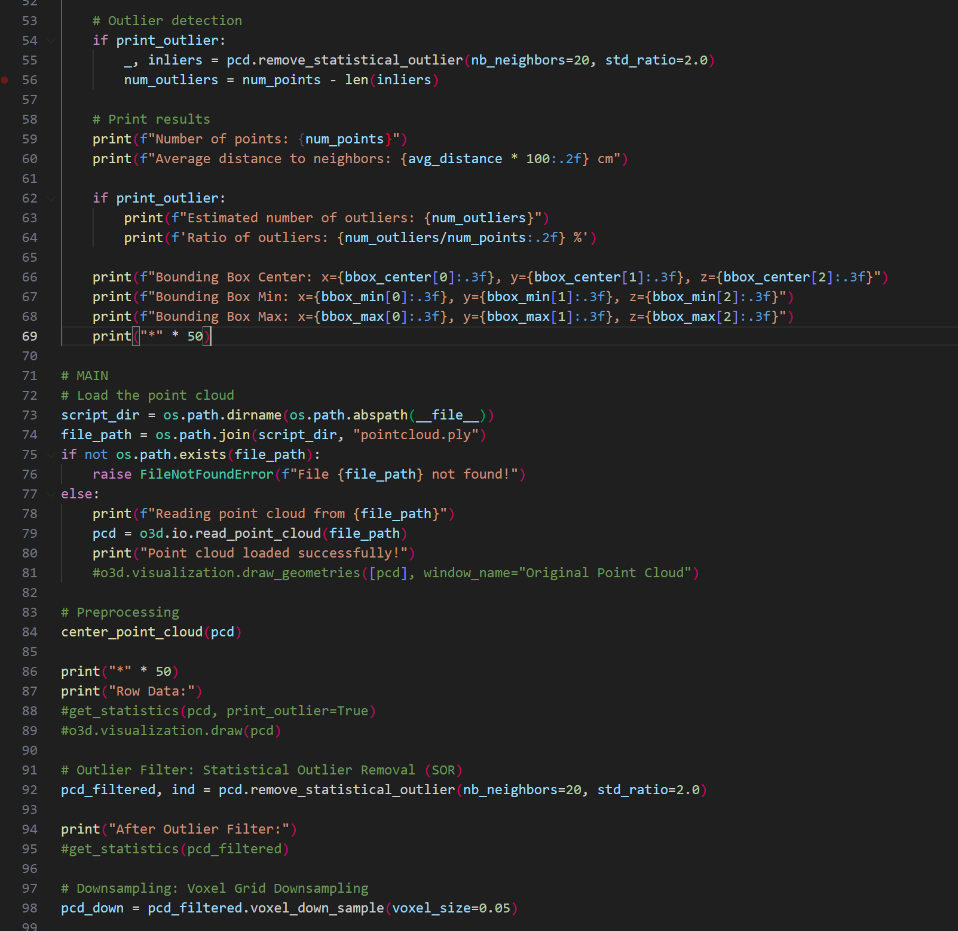
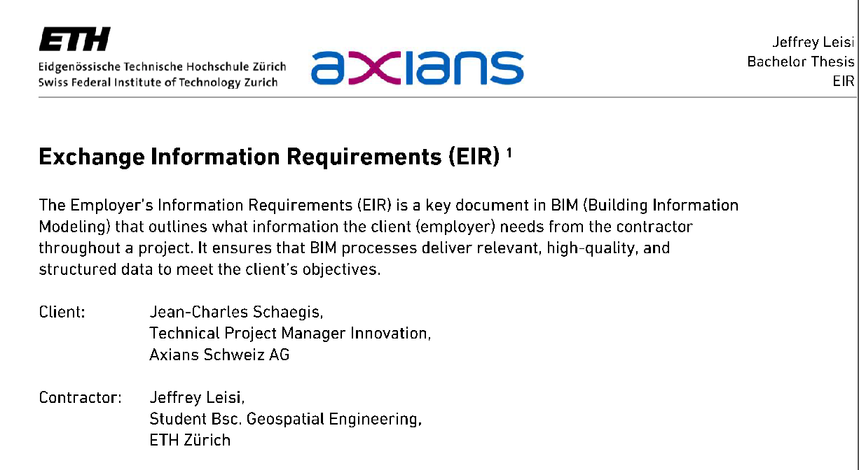
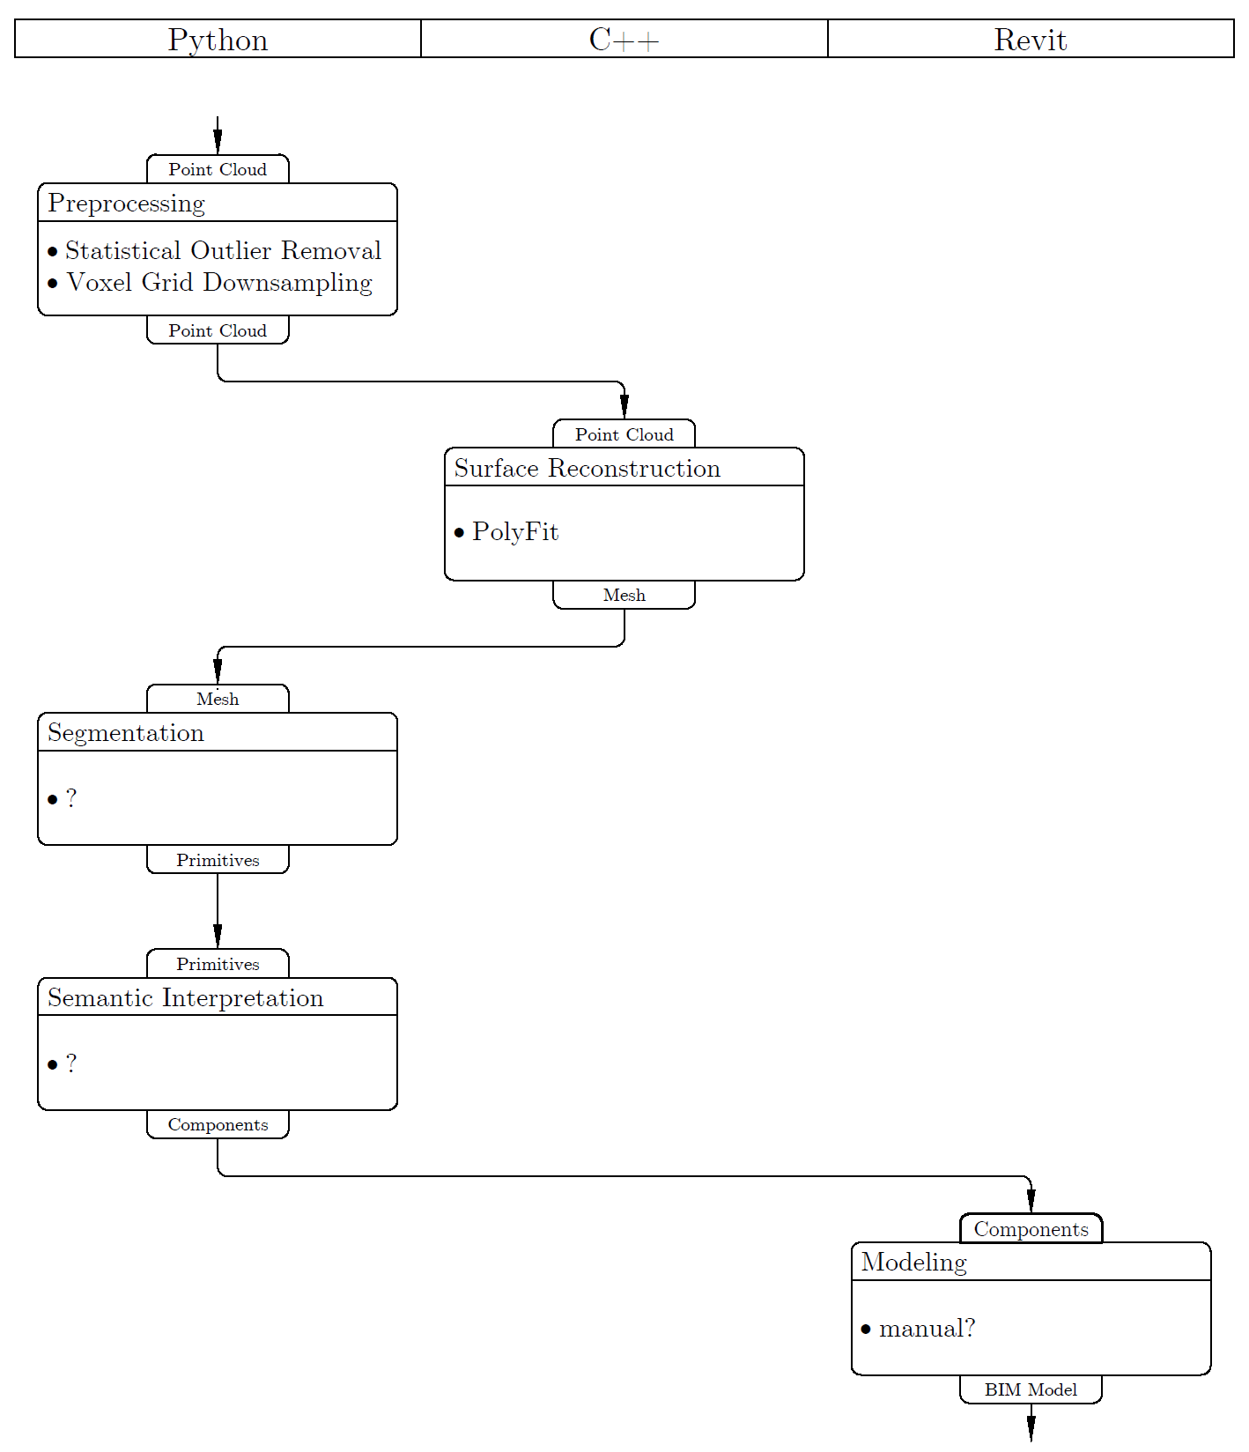

Solution Space: Methodology
Design Science Research Methodology (DSRM) by Peffers et al.
Problem Identification and Motivation ✔️
Definition of the Objectives for a Solution ✔️
Design and Development 🛠️ → Python Script
Demonstration 🕓 → Case Study
Evaluation 🕓
Communication 🕓
Notes:
To meet the scientific requirements, I use a framework called Design Science Research Methodology.
It is problem-oriented and focuses strongly on the development of an artefact.
With six concrete steps, I try to address the research questions:
First, I defined the requirements and objectives from the client. For that, I used a BIM tool called Exchange Information Requirements. It’s a document of about three pages where we specified the project.
Right now, I’m working on the implementation of the artefact. Based on a literature review, I created a framework, which I am now implementing in Python.
After that, I will test the artefact on a real project – this building.
In the end, I will evaluate the results and try to turn the findings into scientific knowledge.
Now, let’s take a look at where I currently stand.

Slide 9
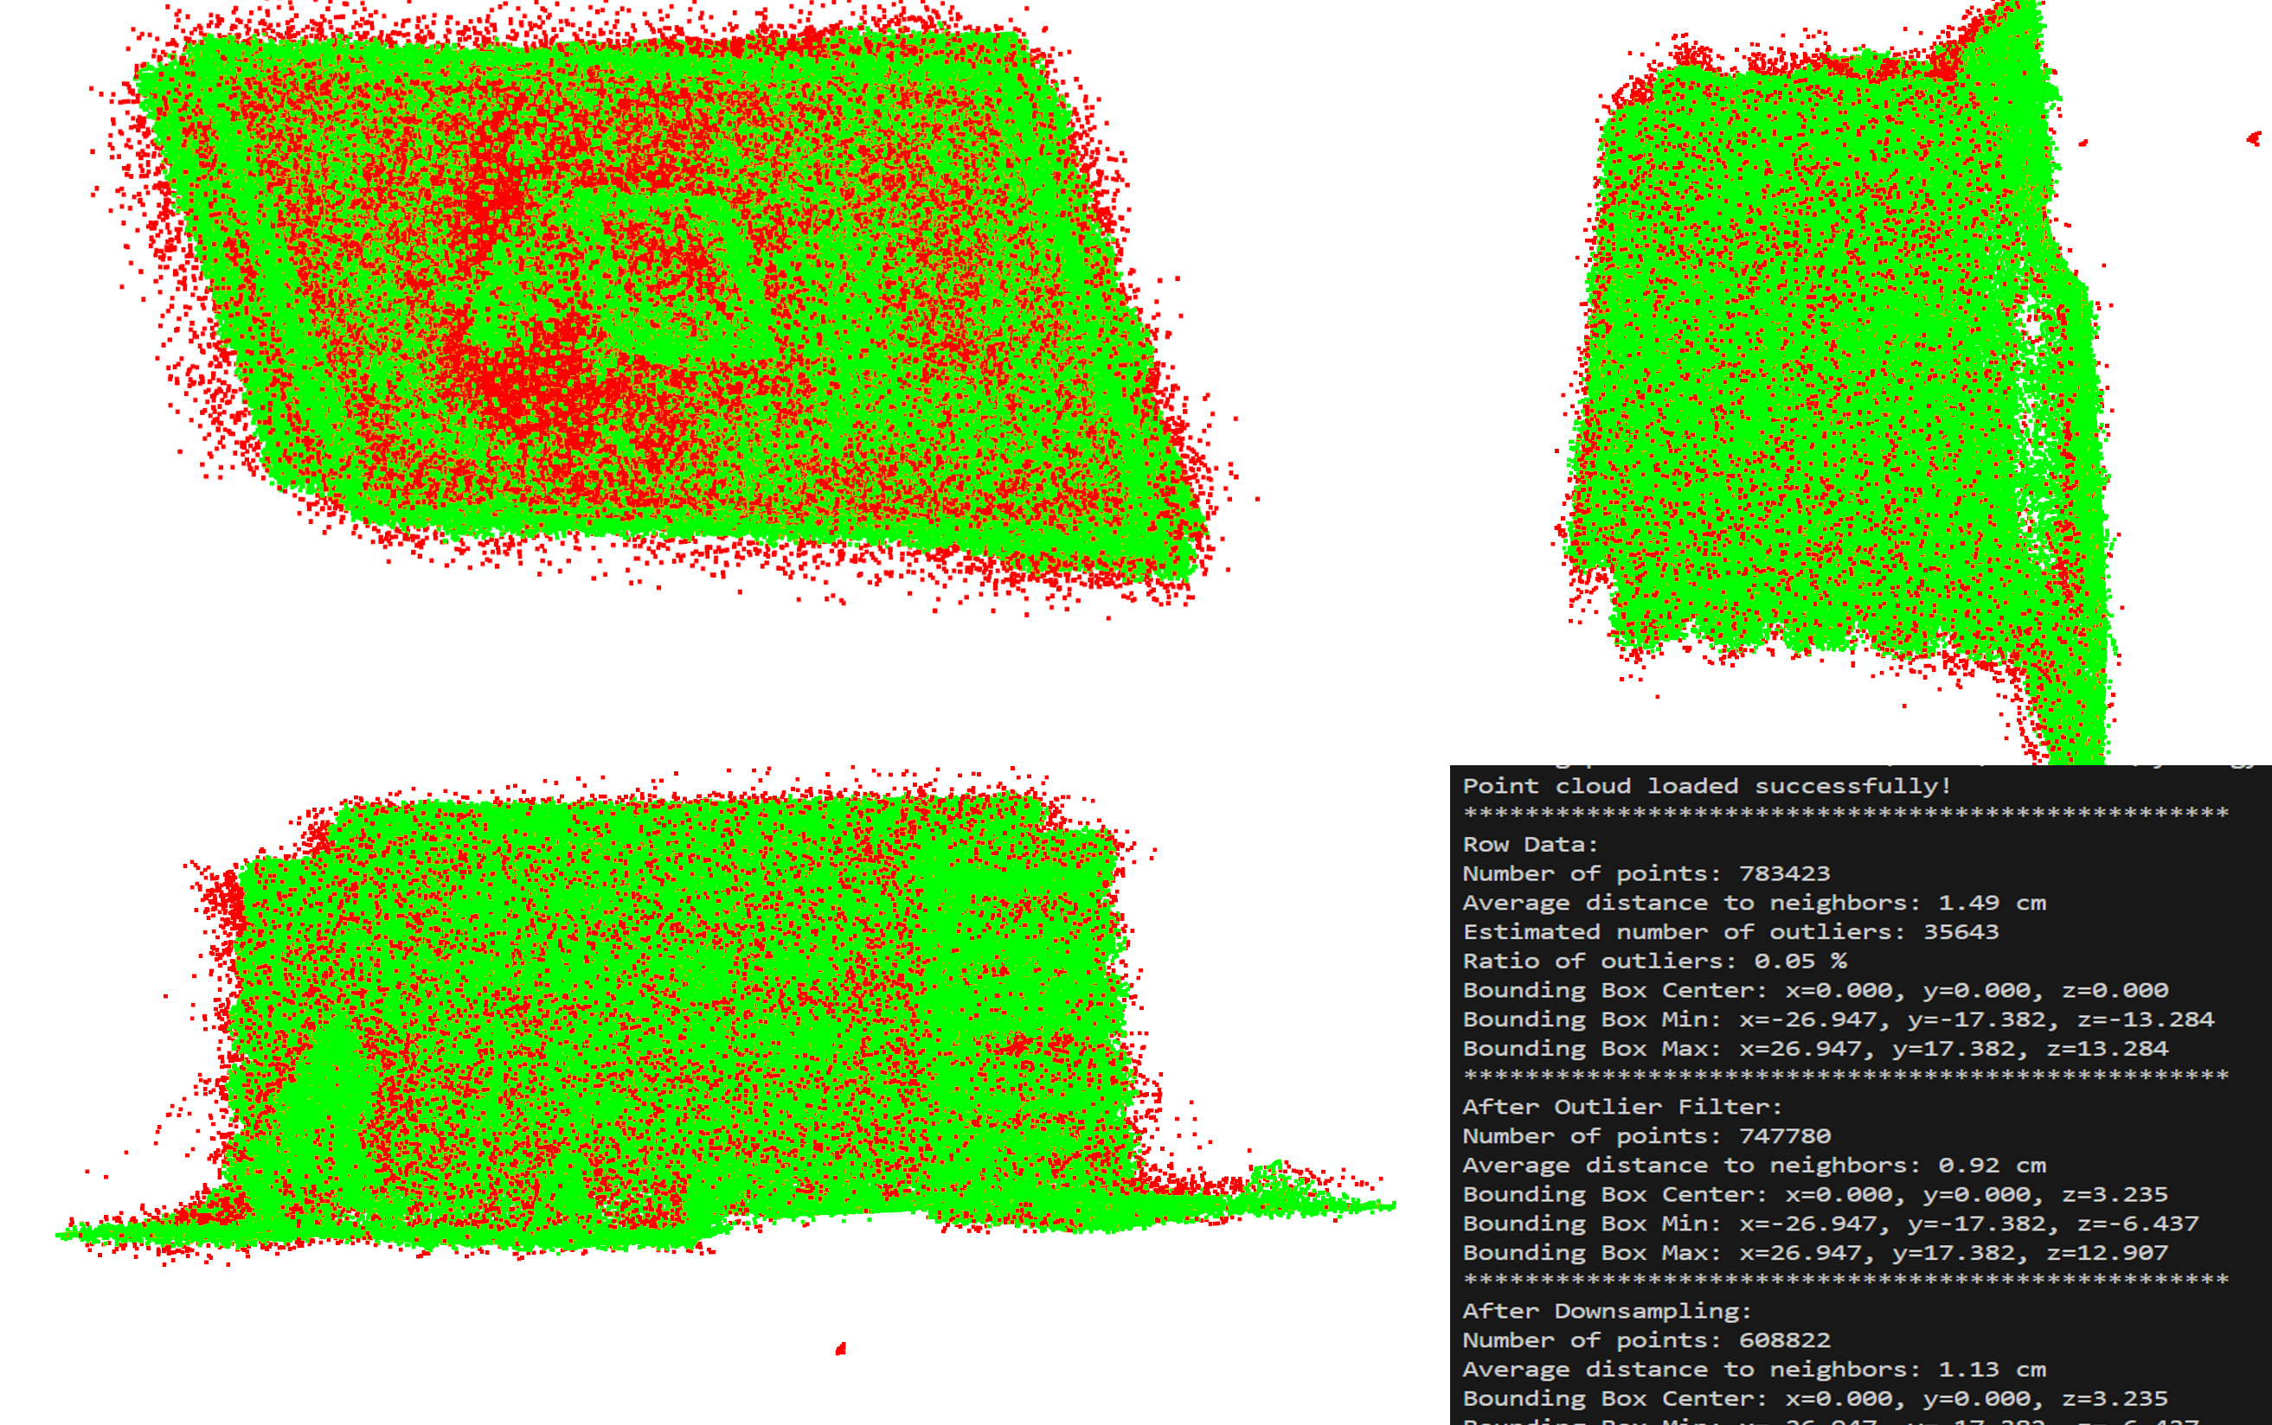
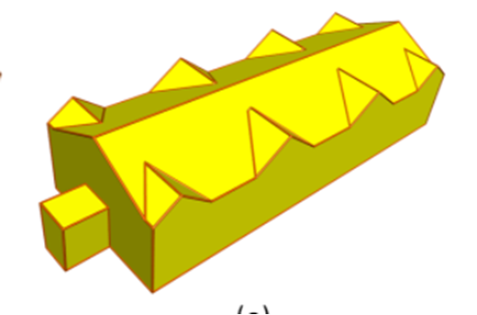
Solution Space: Scan-to-BIM Workflow
Current Status
Scan-to-BIM
Data Acquisition
Preprocessing
Object Extraction
Modeling
Reality Capture
Photogrammetry
LiDAR
Outlier Removal, Downsampling
Python
Extract Building Elements
PolyFit (C++ Software, no CLI) → Python-Wrapper
Modify Building Elements
Autodesk Revit (manual)
Statistical Outlier Removal (SOR)
Voxel Grid Downsampling
Notes:
My Scan-to-BIM workflow consists of four steps:
First, I need a point cloud of the building. This can be done using photogrammetry with a drone, or with a laser scanner. I will receive this data from Axians, so it's outside the scope of my thesis.
Then, I need to prepare the point cloud for further processing. For this, I wrote a simple Python script that detects and removes outliers. I also downsample the point cloud to speed up the processing.
Next, I use the software PolyFit to generate a very simplified mesh. It consists only of planar surfaces. This is a strong generalization, but it makes the problem more manageable. I am currently working on this step, so we will take a closer look at this process on the next slide.
Finally, I will export the objects into Revit, a BIM software.
Ok, now let’s take a closer look at the object extraction in detail.

Slide 10
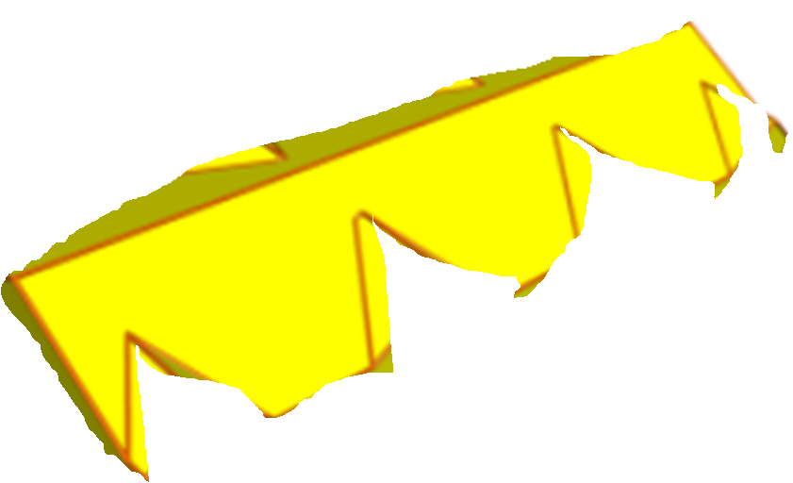

Solution Space: Object Extraction
Current Status
Object Extraction
Meshing
Segmentation
Feature Extraction
Semantic Interpretation
Point Cloud → Mesh
PolyFit Software
Mesh → Geometric Primitives (GP)
(decomose into planar Faces)
GP → Quantitative Features (QF)
QF → rule-based Categorization
n = [x,y,z]
if: z ≈ 0 → Wall
elif: x ^ y ≈ 0 → Flat Roof
else: → Gable Roof
n
n
Ready
for BIM!🍾
BIM Ingredients:
Geometry ✔️
Attributes ✔️
Notes:
To export data into a BIM model, we need to separate the mesh into building elements. In PolyFit, I would say we have three object types: walls, flat roofs, and gable roofs. For each object, we need exactly two things – first, the geometry, and second, the semantic information.
2. With segmentation, we split the model into individual faces. So, from this, we get the geometry.
3. Then we need a way to classify these faces. Since we don’t have any training data for a supervised learning approach, I simply calculate the normal vector of each face.
4. I use this information for classification. For example, if the z-component of the normal vector is close to zero, the face is probably a wall.
I think after these steps, we have the ingredients to leave Python and start modeling in Revit.
But at the moment, I’m still struggling with the PolyFit integration in Python. So, if you notice any problems or have suggestions, I would really appreciate your feedback.

Slide 11

Thank you
Questions?
Creative improvements always welcome! ☺
GitHub
Notes:
Thank you very much!

